Slide 1
PROFESSOR VELAZQUEZ
INTRODUCTION
TO
MICROECONOMICS
MODULE 02 · CONSTRAINED CHOICE OVER TIME
FALL 2025

Slide 2
02
Constrained Choice
Over Time
Section I treats consumer choice in person: utility, indifference curves, and the optimal bundle. Section II is delivered asynchronously: the labor-leisure frontier, intertemporal choice, and the behavioral critique of optimization.
MODULE

Slide 3
MODULE 2 · SECTION II IS ASYNCHRONOUS 📹
Agenda, Big Questions & Opening Inquiry
BIG QUESTIONS
PRE-WORK
WHAT YOU'LL NEED
(1) How do economists model the tradeoff between work and leisure, and between present and future consumption?
(2) Do individuals actually optimize — or do cognitive and institutional limits produce systematic, predictable departures from rationality?
(3) When choice sets are shaped by institutional power rather than individual preference, who designed those constraints — and who benefits?
· Read Chapter 21 (Consumer Choice)
· Complete the Module 2 Vocabulary Checklist
· Khan Academy: Consumer Choice & Utility
· Bring the Module 2 Worksheet
ASYNC FORMAT: watch the recorded lecture with the worksheet at hand. Pause after each Part to complete all activities.
· Module 2 Worksheet (printed)
· Pencil, straight-edge, calculator
· Graph paper for the IC maps and the two-period constraint
· Your Module 1 budget-constraint notes — this module builds directly on them
OPENING INQUIRY
You have exactly 24 hours in a day. Every hour devoted to work is an hour of leisure surrendered. Every dollar saved today is a dollar of present consumption deferred. How do rational agents — and real human beings — resolve these tradeoffs?
SECTION I — IN PERSON (~45 min) | SECTION II — ASYNCHRONOUS 📹
Part 1 · Production function, utility, marginal utility, indifference curves, the optimal bundle | Part 2 · The labor-leisure Feasible Frontier and the monopsony preview Part 3 · Two-period intertemporal choice: Julia, Marco, Hana Part 4 · Behavioral economics: systematic departures from optimization
INTRO TO MICROECONOMICS | PROF. VELAZQUEZ
MODULE 2: CONSTRAINED CHOICE OVER TIME

Slide 4
BEFORE WE BEGIN
Vocabulary Checklist — Module 2
Production Function
Marginal Product of Labor
Diminishing Marginal Product
Utility / Total Utility
Marginal Utility
Law of Diminishing MU
Indifference Curve
MRS
Optimal Consumption Rule
Feasible Frontier
MRT
Institutional Constraint
Monopsony
Intertemporal Budget Constraint
Two-Period Model
Discount Rate
Endowment
Julia (borrower) / Marco (lender)
Bounded Rationality (Simon)
Loss Aversion · Prospect Theory
Hyperbolic Discounting
Present Bias
Bandwidth Tax
Sen's Capabilities Approach
Income vs. Substitution Effect
A DELIBERATE TERMINOLOGICAL NOTE
In Part 2 we call it the FEASIBLE FRONTIER — not the budget constraint. The structure is identical; the context differs. The formal vocabulary bridge to "budget constraint" occurs in Module 6. This distinction is analytically important.
INTRO TO MICROECONOMICS | PROF. VELAZQUEZ
MODULE 2: CONSTRAINED CHOICE OVER TIME

Slide 5
SECTION I
Consumer Theory · In-Person
Part 1 · Production function, marginal product, and diminishing marginal product
Part 1 · Utility, total and marginal utility, and the law of diminishing marginal utility
Part 1 · Indifference curves, MRS, and the optimal consumption rule MUx/Px = MUy/Py

Slide 6
01
Labor Trade-offs, Utility,
the Optimal Bundle & Temporality
PART
OBJECTIVE Define the production function, marginal product, utility and marginal utility; apply the law of diminishing marginal utility; use the optimal consumption rule; locate the optimal bundle where MRS = Px/Py.
INTRO TO MICROECONOMICS | PROF. VELAZQUEZ
MODULE 2: CONSTRAINED CHOICE OVER TIME

Slide 7
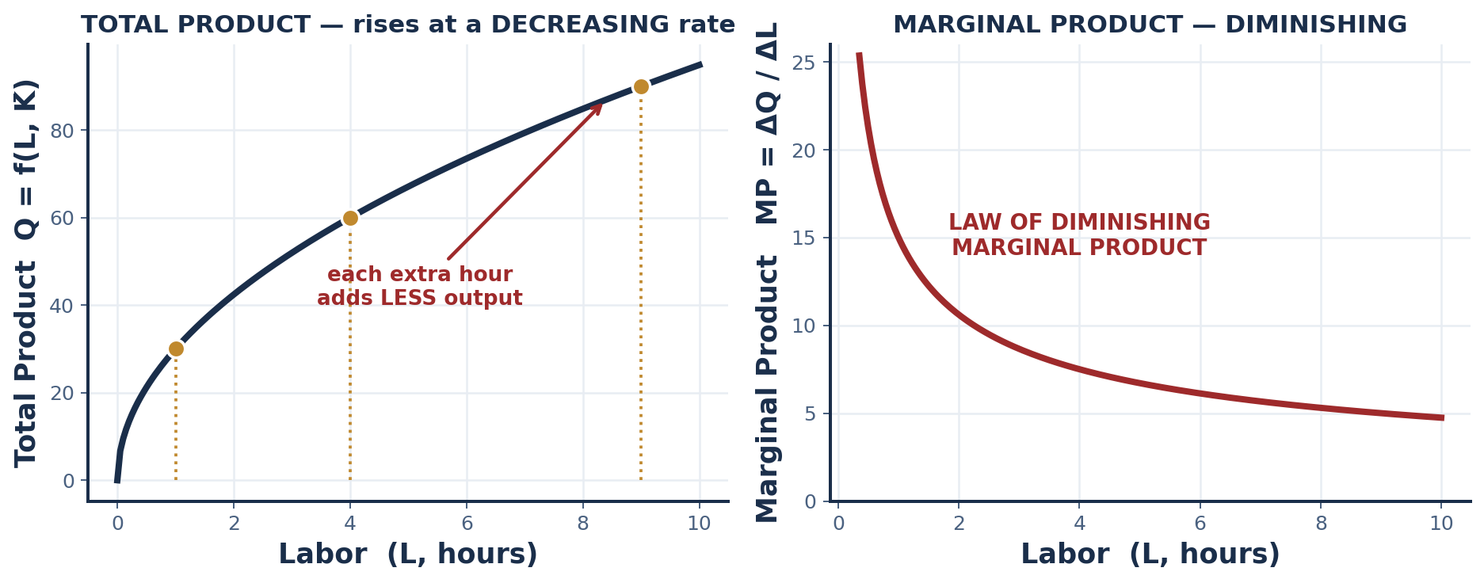
PART 1 · FORMAL DEFINITIONS
The Production Function & Marginal Product
Q = f ( L, K̄ )
Output as a function of variable labor L, holding capital K fixed (the bar denotes a fixed factor — the SHORT RUN, from Module 1).
PRODUCTION FUNCTION
The technological relationship specifying the MAXIMUM output obtainable from each combination of inputs, given the state of technology.
MARGINAL PRODUCT OF LABOR
MP_L = ΔQ / ΔL — the additional output produced by ONE more unit of labor, holding all other inputs constant.
LAW OF DIMINISHING MARGINAL PRODUCT
Beyond some point, adding successive units of a variable input to a FIXED input yields smaller and smaller increments of output. This is the production-side twin of the law of diminishing marginal utility — and the engine of the U-shaped cost curves in Module 9.
INTRO TO MICROECONOMICS | PROF. VELAZQUEZ
MODULE 2: CONSTRAINED CHOICE OVER TIME

Slide 8
PART 1 · ACTIVITY
Production Function Activity — GPA and Study Hours
STUDY ENVIRONMENT | HIGH STUDY TIME → GPA | LOW STUDY TIME → GPA | DIFFERENCE
Good Environment | 3.63 | 3.43 | +0.20
Poor Environment | 3.36 | 3.17 | +0.19
Difference (environment effect) | +0.27 | +0.26
1. WHAT IS THE RELATIONSHIP?
2. WHAT IS HELD CONSTANT?
POSITIVE. Within each environment, moving from low to high study time raises GPA by roughly 0.20 points. Study hours are a productive input: L ↑ → Q ↑. Note also that the environment effect (+0.27) is LARGER than the study-time effect (+0.20) — inputs are not equally productive.
Within each ROW, the study environment is held constant (ceteris paribus) while study time varies. What is NOT held constant across the table is the environment itself — which is precisely why we must read the table by row before comparing across rows.
WHY THIS IS A PRODUCTION FUNCTION
GPA is the output Q. Study hours are the variable input L. The study environment is the fixed capital K̄ — the quality of the desk, the quiet, the internet, the absence of a second job. Two students with identical effort produce different output because they hold different K̄. Hold that thought until Modules 6 and 8.
INTRO TO MICROECONOMICS | PROF. VELAZQUEZ
MODULE 2: CONSTRAINED CHOICE OVER TIME

Slide 9
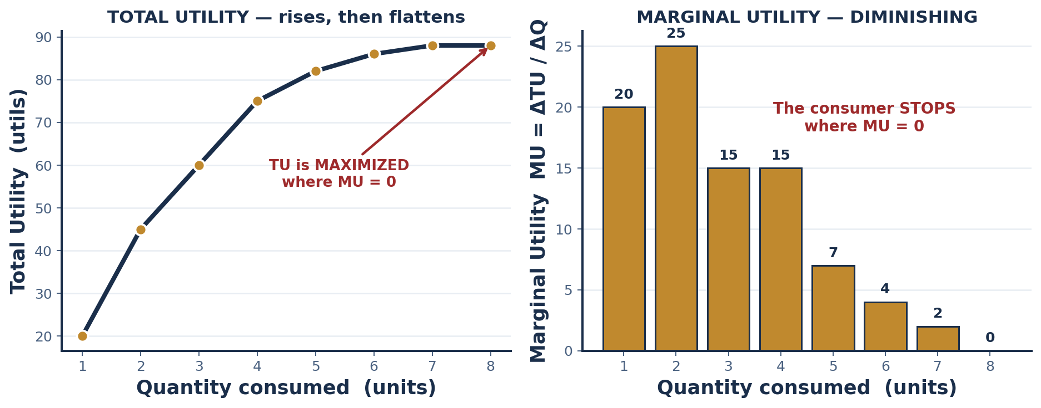
PART 1 · FORMAL DEFINITIONS
Utility, Total Utility & Marginal Utility
UTILITY
TOTAL UTILITY (TU)
MARGINAL UTILITY (MU)
A THEORETICAL INDEX used to represent and rank preferences across bundles of goods.
It provides an ORDERING, not a measurable quantity like dollars or degrees. It does NOT directly measure happiness or satisfaction — a point worth remembering when we get to welfare economics in Module 5.
The total satisfaction — total index value — derived from consuming a given quantity of a good, or from a given bundle of goods.
TU rises as consumption rises, but at a decreasing rate.
MU = ΔTU / ΔQ
The change in total utility from a SINGLE additional unit of a good consumed.
MU is the slope of the total utility curve — the derivative, if you have calculus.
LAW OF DIMINISHING MU
As consumption of a good INCREASES (all else constant), the marginal utility of each additional unit DECREASES.
WHEN DOES A CONSUMER STOP?
Where MU = 0 — total utility is at its maximum. With a price and a budget, they stop earlier: where MU/P is equalized across goods.
INTRO TO MICROECONOMICS | PROF. VELAZQUEZ
MODULE 2: CONSTRAINED CHOICE OVER TIME

Slide 10
PART 1 · THE CORE GEOMETRY
Indifference Curves & the Marginal Rate of Substitution
INDIFFERENCE CURVE (IC)
MARGINAL RATE OF SUBSTITUTION (MRS)
A graph of ALL bundles of goods that yield the SAME level of utility — the consumer is indifferent among every point on one curve.
It shows trade-offs: consume more of Good X and you must give up some Good Y to remain equally satisfied. Each curve is one utility LEVEL; higher curves = higher utility.
MRS = −ΔY/ΔX = MUx / MUy — the rate at which a consumer is WILLING to trade Y for X while remaining indifferent. It is the slope of the indifference curve.
DIMINISHING MRS: as consumption of X rises, the consumer is willing to give up LESS Y per additional X. This is what makes the IC convex to the origin.
THE FOUR STANDARD PROPERTIES OF INDIFFERENCE CURVES | WHY
Higher curves are preferred to lower curves | More is better (monotonicity).
Indifference curves are downward-sloping | To stay equally satisfied with more X, you must have less Y.
Indifference curves never cross | Crossing would violate transitivity of preferences.
Indifference curves are bowed inward (convex) | Diminishing MRS — people prefer balanced bundles to extreme ones.
TWO DIFFERENT SLOPES, TWO DIFFERENT MATHEMATICS
The BUDGET line is LINEAR — its slope is constant along the line, so algebra suffices. PREFERENCE is NONLINEAR — its slope changes along the entire curve, so the honest tool is the derivative. Optimization sets the two slopes equal.
INTRO TO MICROECONOMICS | PROF. VELAZQUEZ
MODULE 2: CONSTRAINED CHOICE OVER TIME

Slide 11
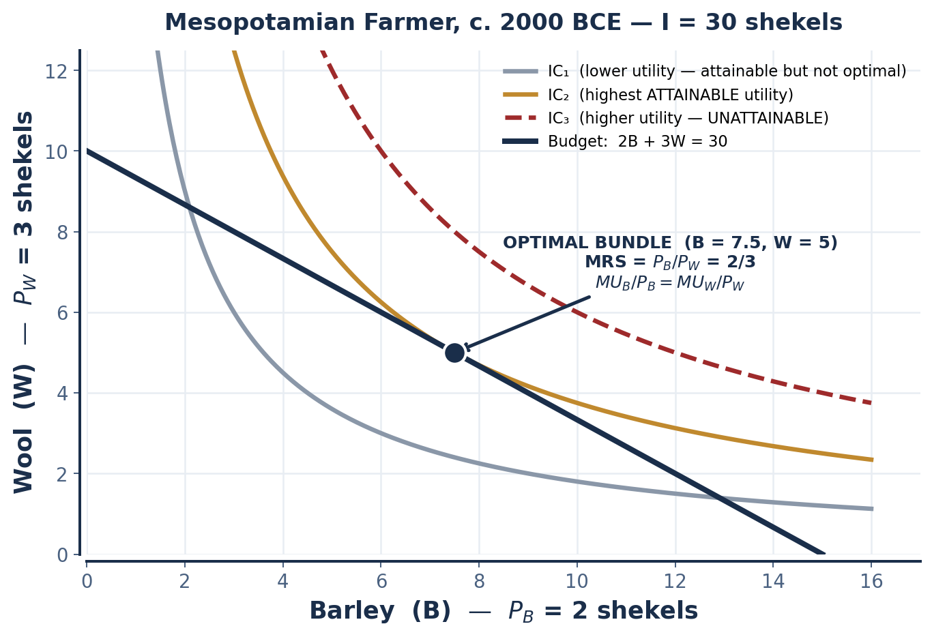
SCENARIO · MESOPOTAMIA, C. 2000 BCE
The Optimal Bundle — Where Two Slopes Meet
A farmer allocates 30 shekels between barley (B, price = 2 shekels) and wool (W, price = 3 shekels). Identify where he maximizes utility subject to his budget.
BARLEY | WOOL | TU | COST CHECK | ON BUDGET?
0 | 10 | 80 | 0 + 30 = 30 | Yes
3 | 8 | 110 | 6 + 24 = 30 | Yes
7.5 | 5 | ≈120 | 15 + 15 = 30 | Yes — OPTIMAL
10 | 3 | 120 | 20 + 9 = 29 | Nearly — 1 unspent
15 | 0 | 90 | 30 + 0 = 30 | Yes
MU_B / P_B = MU_W / P_W
OPTIMAL CONSUMPTION RULE — the last shekel spent on barley must
buy the same utility as the last shekel spent on wool.
WHY THE RULE MUST HOLD
If MU_B/P_B > MU_W/P_W, shifting one shekel from wool to barley raises total utility at no cost. Any inequality is an unexploited gain — so at the optimum the ratios must be equal.
INTRO TO MICROECONOMICS | PROF. VELAZQUEZ
MODULE 2: CONSTRAINED CHOICE OVER TIME

Slide 12
PART 1 · WORKSHEET ✦1
Why Tangency — and Not Crossing
1
GEOMETRICALLY
2
INTUITIVELY
3
WHAT CROSSING WOULD MEAN
At a tangency the two curves share a single point and an identical slope: the slope of the budget line (−Px/Py) equals the slope of the indifference curve (−MRS).
If the budget line CROSSED an indifference curve, it would enter the region above that curve — meaning a strictly higher indifference curve is still affordable. The consumer has not yet maximized.
MRS is what the consumer is WILLING to trade. Px/Py is what the market REQUIRES them to trade.
When willingness exceeds the market rate, the consumer should buy more X — the trade makes them better off. Only when the two rates are equal is there no remaining profitable trade. Optimization ends where the private exchange rate meets the market exchange rate.
A crossing point is FEASIBLE but not OPTIMAL — the consumer is spending their whole income while reaching a lower utility level than they could.
This is exactly the Module 1 distinction between points ON the budget line (efficient in the budget sense) and the single point that is also optimal in the preference sense.
MRS = MUx / MUy = Px / Py ⟺ MUx / Px = MUy / Py
These are the same condition written two ways. The left form is geometric (slopes are equal); the right form is arithmetic (utility per dollar is equalized). Know both — assessments ask for either.
THE BRIDGE TO MODULE 3
This tangency, repeated across every consumer in a market and summed horizontally, IS the market demand curve. Module 3 will simply assume the result and draw the line — but this is where the line comes from.
INTRO TO MICROECONOMICS | PROF. VELAZQUEZ
MODULE 2: CONSTRAINED CHOICE OVER TIME

Slide 13
SECTION II
Consumer Theory · Asynchronous 📹
Part 2 · The labor-leisure Feasible Frontier, MRT, and the monopsony preview
Part 3 · Intertemporal choice: the two-period model, borrowers, lenders and the interest rate
Part 4 · Behavioral economics: bounded rationality, loss aversion, present bias and the bandwidth tax

Slide 14
02
The Labor-Leisure
Feasible Frontier
PART
OBJECTIVE Construct the labor-leisure Feasible Frontier; define MRT (wage = opportunity cost of leisure); identify the optimal allocation where MRS = MRT; apply the Marcus & Ray case.
INTRO TO MICROECONOMICS | PROF. VELAZQUEZ
MODULE 2: CONSTRAINED CHOICE OVER TIME

Slide 15
PART 2 · FORMAL DEFINITIONS
The Feasible Frontier & the Marginal Rate of Transformation
FEASIBLE FRONTIER
MRT — MARGINAL RATE OF TRANSFORMATION
WAGE = OC OF LEISURE
The boundary of the set of combinations of leisure and income an agent can attain, given the wage rate and the total hours available. Structurally identical to a budget constraint — but the constraint here is TIME converted into income, not income allocated across goods.
The slope of the feasible frontier: the rate at which the agent can TRANSFORM leisure into income. It equals the OPPORTUNITY COST of consuming one more hour of leisure.
MRT = the wage rate w.
Each hour NOT worked costs exactly one hour of wages. At w = $15, an hour of leisure costs $15 in forgone earnings.
The wage is therefore the PRICE OF LEISURE — which is why leisure obeys the same logic as any other good.
Optimal allocation: MRS = MRT = w
The rate at which the worker is WILLING to trade leisure for income equals the rate at which the labor market lets them.
This is the same tangency condition as Part 1 — the goods are simply leisure and income instead of barley and wool.
LEISURE HOURS | WORK HOURS | WEEKLY EARNINGS ($) | FEASIBLE? | SLOPE / MRT
60 | 0 | 0 | Yes — corner | −15
45 | 15 | 225 | Yes | −15
30 | 30 | 450 | Yes | −15
15 | 45 | 675 | Yes | −15
0 | 60 | 900 | Yes — corner | −15
INTRO TO MICROECONOMICS | PROF. VELAZQUEZ
MODULE 2: CONSTRAINED CHOICE OVER TIME

Slide 16
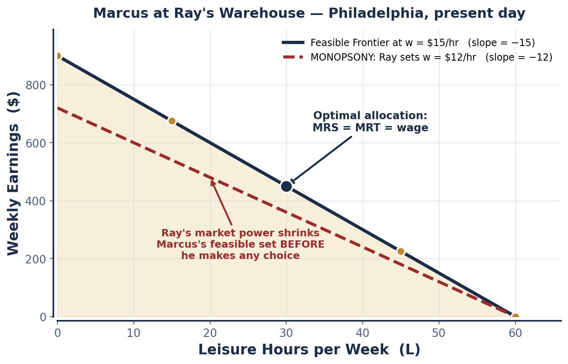
SCENARIO · PHILADELPHIA, PRESENT DAY
Marcus at Ray's Warehouse — and the Monopsony Preview
Marcus can work up to 60 hours per week at Ray's warehouse, earning $15 per hour. Each hour of work yields $15 in income; each hour of leisure costs $15 in forgone earnings.
Earnings = w · (60 − L) = 900 − 15L
Vertical intercept = 900 (all 60 hours worked). Horizontal intercept = 60 (all hours as leisure).
Slope = −w = −15.
MONOPSONY — the preview
A market with a single (or dominant) BUYER. In a monopsonistic labor market the employer sets the wage unilaterally rather than taking it from the market.
If Ray, as the neighborhood's dominant employer, pays $12/hr instead of $15/hr, Marcus's frontier ROTATES INWARD about the leisure intercept: max earnings fall from $900 to $720.
✦2 THE LIMITS OF "INDIVIDUAL DECISION-MAKING"
Ray's market power constrains Marcus's attainable income BEFORE Marcus has made a single choice. The model of optimization is intact — Marcus still picks the best point on his frontier — but WHICH frontier he faces was decided by someone else. Optimization explains behavior within a choice set; it does not explain who drew the choice set.
INTRO TO MICROECONOMICS | PROF. VELAZQUEZ
MODULE 2: CONSTRAINED CHOICE OVER TIME

Slide 17
PART 2 · ASYNC PERSONAL APPLICATION
Build Your Own Feasible Frontier
1
CONSTRUCT IT
2
FIND THE CONSTRAINT
3
ASK THE TWO QUESTIONS
Build your own labor-leisure OR saving-spending feasible frontier. Use real numbers: your actual available hours, your actual wage or your actual weekly income.
Label both intercepts, the slope, and the point you currently occupy.
Identify at least ONE institutional constraint that shapes your feasible set. Candidates: a minimum wage, a maximum course load, a scholarship hour cap, a lease, a visa work restriction, a family obligation, transit schedules.
WHO DESIGNED THAT CONSTRAINT?
WHO BENEFITS FROM IT?
Write two or three sentences. These are the questions Modules 6, 7 and 8 are built on — you are answering them now, at the scale of your own week.
INSTITUTIONAL CONSTRAINT — formal definition
A rule, law, contract, or structure of market power that determines the boundaries of an agent's feasible set independently of that agent's preferences or productivity. Institutional constraints are the reason two equally capable people can face entirely different opportunity sets — and the reason distributional questions cannot be settled by preference alone.
CARRY THIS FORWARD
MODULE 6 will formalize the labor market as a factor market with supply and demand. MODULE 8 will show what happens when the employer has power on one side of it. Everything you write on this exercise is a data point for those modules.
INTRO TO MICROECONOMICS | PROF. VELAZQUEZ
MODULE 2: CONSTRAINED CHOICE OVER TIME

Slide 18
03
Intertemporal Choice:
Borrowers, Lenders & the Interest Rate
PART
OBJECTIVE Model the two-period intertemporal budget constraint; contrast Julia (borrower) and Marco (lender); trace the consequences of interest-rate changes.
INTRO TO MICROECONOMICS | PROF. VELAZQUEZ
MODULE 2: CONSTRAINED CHOICE OVER TIME

Slide 19
PART 3 · THE TWO-PERIOD MODEL
The Intertemporal Budget Constraint
C₂ = ( Y₁ − C₁ ) ( 1 + r ) + Y₂
Period-2 consumption equals period-2 income plus period-1 saving carried forward at interest. If C₁ > Y₁ the first term is NEGATIVE — the agent is borrowing, and repays principal plus interest out of Y₂.
CONCEPT | FORMULA OR RULE | ECONOMIC INTERPRETATION
Intertemporal constraint | C₂ = (Y₁ − C₁)(1 + r) + Y₂ | The complete set of consumption paths reachable given income in both periods and access to credit at rate r.
Slope of the constraint | −(1 + r) | To get $1 more NOW, you must give up $1 + $1×r of consumption LATER. The interest rate IS the price of present consumption.
Endowment point | (C₁, C₂) = (Y₁, Y₂) | The no-borrowing, no-lending point. The constraint always passes through it, so a change in r rotates the line ABOUT this point.
Discount rate (r) | the market interest rate | The rate at which future dollars are converted into present dollars. Present value of $X received next period = X / (1 + r).
Julia — BORROWER | C₁ > Y₁ | A net BUYER of present consumption. Consumes more than current income now; repays with interest later.
Marco — LENDER | C₁ < Y₁ | A net SELLER of present consumption. Saves now; consumes principal plus interest later.
THE ONE SENTENCE TO REMEMBER
THE INTEREST RATE IS THE OPPORTUNITY COST OF PRESENT CONSUMPTION. Everything else in Part 3 follows from that.
INTRO TO MICROECONOMICS | PROF. VELAZQUEZ
MODULE 2: CONSTRAINED CHOICE OVER TIME

Slide 20
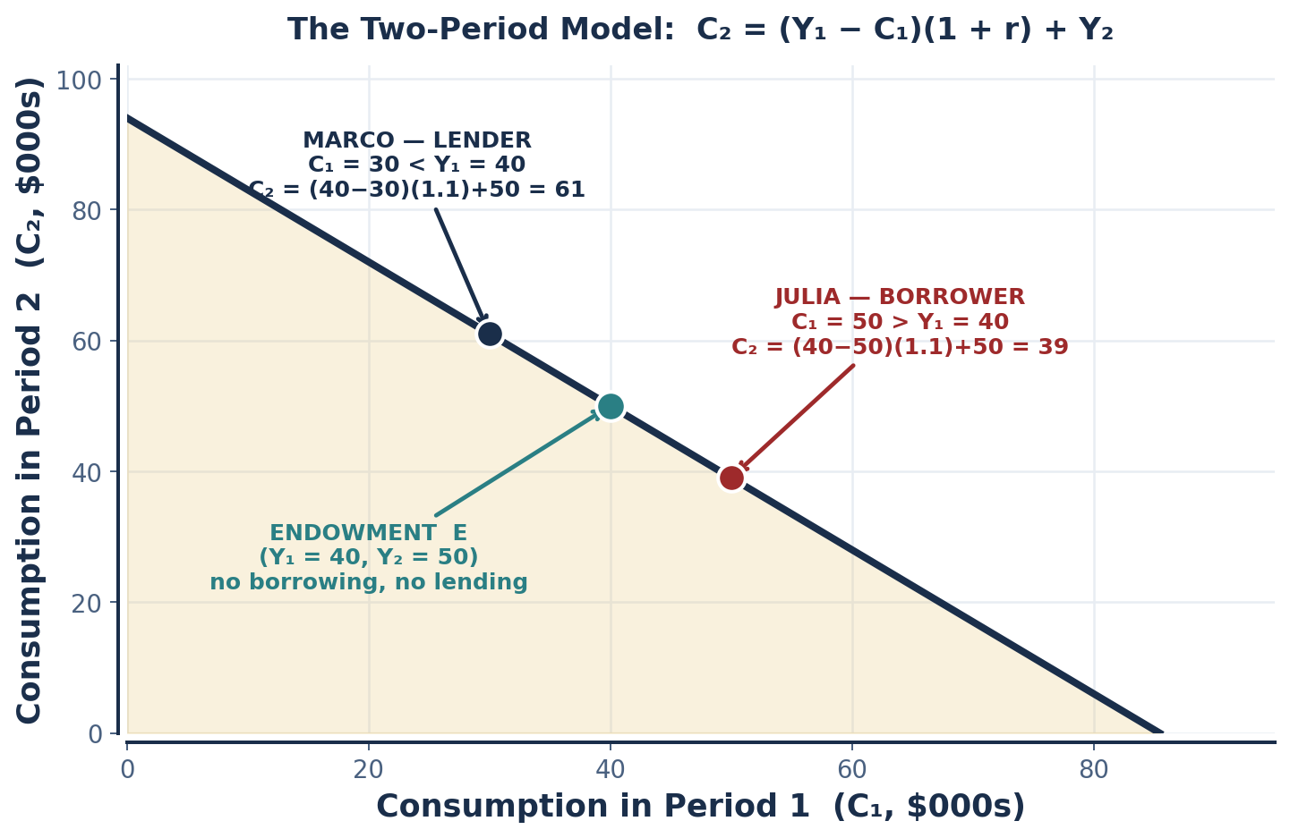
SCENARIO · JULIA & MARCO
Computing the Two-Period Model
Given: Y₁ = $40,000; Y₂ = $50,000; r = 10%. Julia chooses C₁ = $50,000 (borrows). Marco chooses C₁ = $30,000 (saves). Compute C₂ for each.
JULIA — THE BORROWER
C₂ = (40,000 − 50,000)(1.10) + 50,000
C₂ = (−10,000)(1.10) + 50,000
C₂ = −11,000 + 50,000 = $39,000
She consumes $10,000 more today and gives up $11,000 tomorrow. The $1,000 gap is the interest — the price she paid for time.
MARCO — THE LENDER
C₂ = (40,000 − 30,000)(1.10) + 50,000
C₂ = (10,000)(1.10) + 50,000
C₂ = 11,000 + 50,000 = $61,000
He gives up $10,000 today and receives $11,000 tomorrow. The $1,000 is what he was paid for waiting.
CHECK YOUR WORK
Both points must lie on the SAME line. Both do: the constraint runs from (0, 94,000) to (85,455, 0), passing through the endowment (40,000, 50,000).
INTRO TO MICROECONOMICS | PROF. VELAZQUEZ
MODULE 2: CONSTRAINED CHOICE OVER TIME

Slide 21
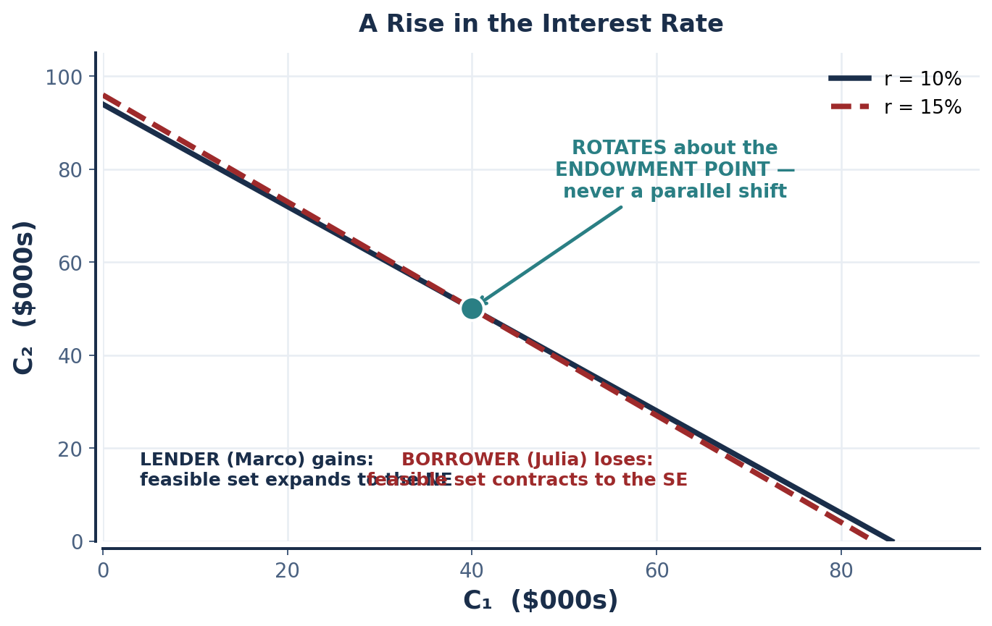
PART 3 · COMPARATIVE STATICS
What Happens When the Interest Rate Rises to 15%?
JULIA (BORROWER) — WORSE OFF
Borrowing becomes more EXPENSIVE. Her feasible set CONTRACTS in the region where C₁ > Y₁. At C₁ = 50,000 her C₂ falls from $39,000 to (−10,000)(1.15) + 50,000 = $38,500.
MARCO (LENDER) — BETTER OFF
Lending earns MORE. His feasible set EXPANDS in the region where C₁ < Y₁. At C₁ = 30,000 his C₂ rises from $61,000 to (10,000)(1.15) + 50,000 = $61,500.
INCOME vs. SUBSTITUTION EFFECT
SUBSTITUTION EFFECT (everyone): r ↑ → present consumption is more expensive → shift consumption TOWARD LATER.
INCOME EFFECT (lender): r ↑ → the feasible set EXPANDS → Marco can afford more in BOTH periods, which pushes toward more present consumption too. For a lender the two effects OPPOSE each other; for a borrower they REINFORCE, so a borrower unambiguously cuts present consumption.
✦3 WHO BENEFITS FROM A RISING RATE?
NET SELLERS of present consumption — lenders and savers. NET BUYERS — borrowers — are made worse off. The rate is a price, and a price change always helps one side of the market.
INTRO TO MICROECONOMICS | PROF. VELAZQUEZ
MODULE 2: CONSTRAINED CHOICE OVER TIME

Slide 22
SCENARIO · SEOUL 1968 & PHILADELPHIA TODAY
Hana, Marcus, and the Structural Credit Barrier
HANA IN SEOUL — SOUTH KOREA, 1968
MARCUS TODAY — THE $15,000 FOOD CART
Hana works in a textile factory earning $8 per week. She wants a $100 sewing machine to establish her own enterprise. The only available credit carries 60% per annum.
Monthly earnings ≈ $8 × 4.33 = $34.67
Simple interest on $100 at 60% APR = $60/year ≈ $5.00/month, plus principal. A 12-month repayment ≈ $13.33/month — roughly 38% of her monthly income before food, rent or transport.
The loan sits at the edge of, and most likely outside, her feasible set — even though the machine would raise her productivity.
At 6% APR, Marcus can service the debt: the investment's return exceeds the cost of capital, so borrowing is rational and welfare-improving.
At 300% APR (payday lending), he cannot. The identical investment, the identical person, the identical productivity — and the project is now impossible.
This is not a preference difference. It is a STRUCTURAL BARRIER: differential access to credit at different prices, determined by which institutions will lend to whom.
Borrow if and only if: return on investment > r
Marcus's risky-investment case: he borrows at 78% to repair a car, and each $1 invested returns $3 next year — a 200% return against a 78% cost. He SHOULD borrow.
The arithmetic does not care that 78% sounds outrageous; it cares only whether the return exceeds the rate.
✦4 WHAT INSTITUTION COULD CHANGE THE FEASIBLE SET?
A prohibitive rate does not merely make borrowing expensive — it renders productive investment STRUCTURALLY INACCESSIBLE, making saving the only rational path even when borrowing would generate higher long-run welfare. Candidate institutions: a credit union or community development financial institution; a microfinance lender; a public loan guarantee; usury caps; a state development bank. Each one changes the line, not the preference. Return to this in Modules 6 and 8.
INTRO TO MICROECONOMICS | PROF. VELAZQUEZ
MODULE 2: CONSTRAINED CHOICE OVER TIME

Slide 23
04
Behavioral Economics:
Systematic Departures from Optimization
PART
OBJECTIVE Define bounded rationality (Simon); explain loss aversion and prospect theory (Kahneman & Tversky); apply the bandwidth tax (Mullainathan & Shafir); introduce Sen's capabilities approach as a normative critique.
INTRO TO MICROECONOMICS | PROF. VELAZQUEZ
MODULE 2: CONSTRAINED CHOICE OVER TIME

Slide 24
PART 4 · THE CONCEPTUAL TABLE
Seven Departures from the Rational-Agent Model
CONCEPT & THEORIST | PRECISE DEFINITION | APPLICATION TO MARCUS
Bounded Rationality (Simon, 1955) | Agents optimize subject to cognitive limits of ATTENTION, INFORMATION and TIME. They SATISFICE — accept the first option meeting a threshold — rather than maximize. | Marcus does not compare all twelve lenders. He takes the first that approves him, because searching costs hours he does not have.
Loss Aversion (Kahneman & Tversky) | Losses are weighted more heavily than equivalent gains — experimentally, by a factor of approximately 2 to 2.5. | Losing his current $15/hr job feels roughly twice as bad as an equivalent raise feels good — so he stays with Ray.
Prospect Theory (1979) | Outcomes are evaluated as gains and losses RELATIVE TO A REFERENCE POINT, not as absolute wealth levels; the value function is concave in gains, convex and steeper in losses. | Whether the food cart looks like a gain or a loss depends entirely on whether Marcus frames it against his current income or his hoped-for income.
Hyperbolic Discounting | The discount rate is not constant: the near future is discounted very steeply, the far future barely at all — producing time-inconsistent plans. | He plans to start saving next month, every month. The plan is sincere each time and reversed each time.
Present Bias | The systematic overweighting of immediate payoffs relative to delayed ones — the behavioral consequence of hyperbolic discounting. | $50 now beats $60 next week, even though no market rate justifies it.
Bandwidth Tax (Mullainathan & Shafir) | Managing scarcity consumes cognitive resources, directly reducing capacity for PLANNING, IMPULSE CONTROL, and long-horizon decision-making. | Juggling rent, hours and transport leaves less mental bandwidth for the very financial planning that would end the juggling.
Sen's Capabilities Approach | Welfare should be measured by what individuals can actually DO and BE — their real freedoms — not merely by what they consume or earn. | Marcus's income is one number. His capability set — whether he can start a business, move, or study — is the thing that actually changed.
THE UNIFYING CLAIM OF BEHAVIORAL ECONOMICS
These are not random errors. They are SYSTEMATIC and PREDICTABLE departures from the optimizing model — which means they can be modeled, measured, and in principle corrected by institutional design. A random error would average out across a population; a systematic bias does not. That is precisely why Part 4 belongs in an economics course rather than a psychology one, and it is the foundation of the policy tools in Module 12.
INTRO TO MICROECONOMICS | PROF. VELAZQUEZ
MODULE 2: CONSTRAINED CHOICE OVER TIME

Slide 25
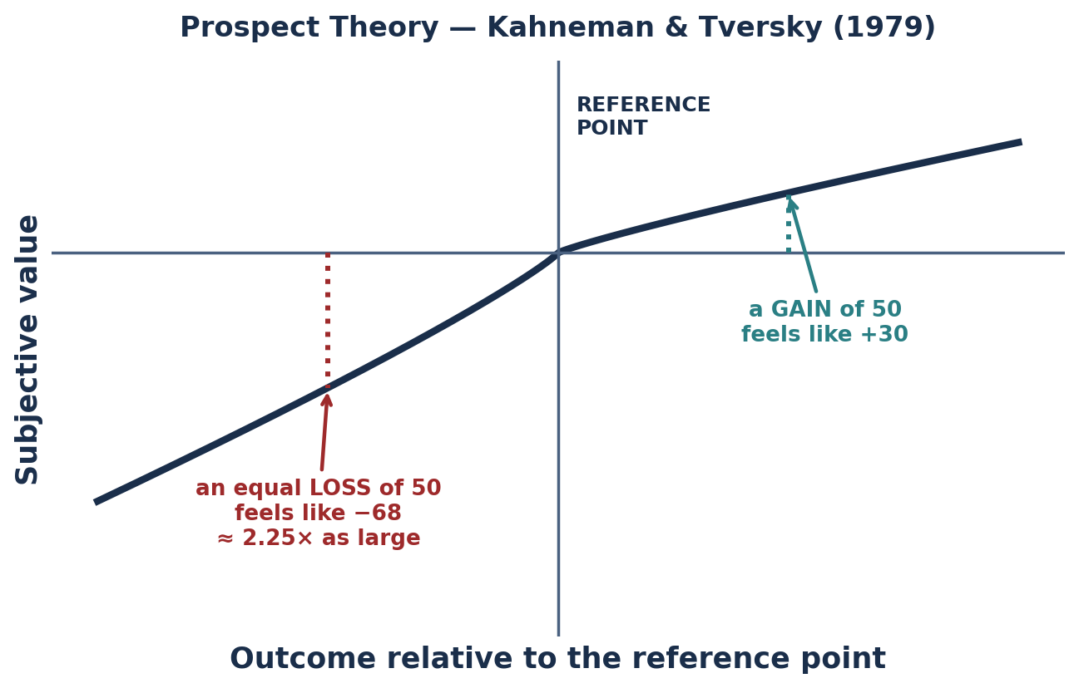
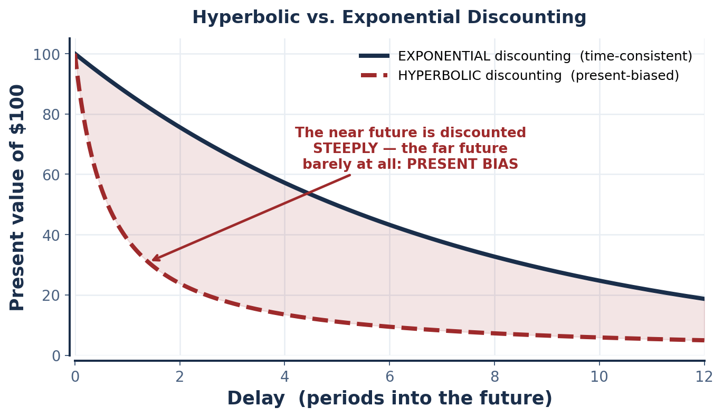
PART 4 · THE TWO CENTRAL DIAGRAMS
Prospect Theory & Hyperbolic Discounting
LOSS AVERSION — the measurement
TIME INCONSISTENCY — the consequence
Experimental evidence shows losses feel approximately 2 to 2.5 times larger than equivalent gains. The value function has a KINK at the reference point.
Under hyperbolic discounting, the plan you make for next month is not the plan you will execute when next month arrives. Preferences reverse without any new information.
INTRO TO MICROECONOMICS | PROF. VELAZQUEZ
MODULE 2: CONSTRAINED CHOICE OVER TIME

Slide 26
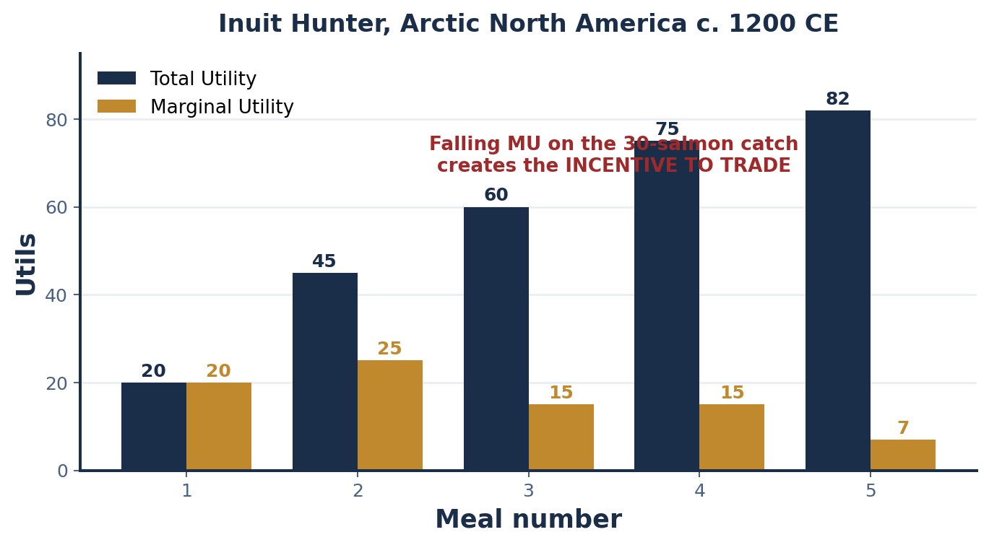
SCENARIO · ARCTIC NORTH AMERICA, C. 1200 CE
The Inuit Hunter — Diminishing MU and the Incentive to Trade
A hunter takes 30 salmon in a single morning. After roughly 10 meals, each additional salmon meal yields diminishing marginal utility. This surplus creates a structural incentive for trade — but behavioral constraints complicate the decision.
MEAL | TOTAL UTILITY | MARGINAL UTILITY | INCENTIVE TO TRADE
1 | 20 | 20 | Low
2 | 45 | 25 | Low
3 | 60 | 15 | Rising
4 | 75 | 15 | Rising
5 | 82 | 7 | HIGH
THE ECONOMIC LOGIC
As MU of own consumption falls toward zero, the utility obtainable by TRADING the surplus for something with high MU rises. Falling marginal utility is what makes exchange mutually beneficial — the same insight that produced gains from trade in Module 1.
INSTITUTIONS THAT CORRECT THE DISTORTION
✦5 The behavioral complication
Storage and preservation technology (drying racks, ice caches) that make the future tangible. Reciprocal-obligation norms and kinship sharing rules that convert an uncertain future return into a socially enforced one. Regular trading gatherings that lower search costs. Each is an institution that changes the choice set rather than the person — Ostrom's insight, previewed.
Present bias makes the CERTAIN salmon in hand loom larger than the uncertain, delayed return from trade. The bandwidth tax of acute material scarcity narrows attention to today's meal.
INTRO TO MICROECONOMICS | PROF. VELAZQUEZ
MODULE 2: CONSTRAINED CHOICE OVER TIME

Slide 27
YOU TRY
Module 2 — Independent Practice
Complete all four Parts of the Module 2 Worksheet, including the Personal Feasible Frontier task at the end of Part 2.
Khan Academy: Consumer Choice — utility maximization, indifference curves, budget constraints. Reach mastery.
Draw all three required graphs by hand: the IC map with tangency, Marcus's labor-leisure frontier, and the two-period constraint with the endowment point labeled.
Answer reflection questions ✦1 through ✦5 in complete sentences.
HOMEWORK RULE OF THUMB: above 80% → move on. Below 80% → retry once or twice. Consistently below 80% → office hours, immediately.
ASYNC
INTRO TO MICROECONOMICS | PROF. VELAZQUEZ

Slide 28
MODULE 2
What You Should Be Able to Do
 | LEARNING OUTCOME
Part 1 | Define the production function, marginal product and diminishing marginal product; define utility, TU and MU; compute MU from a TU schedule; state and apply the law of diminishing marginal utility; draw an indifference map with the correct four properties; locate the optimal bundle and justify tangency both geometrically and arithmetically.
Part 2 | Construct a labor-leisure feasible frontier from a wage and an hours endowment; identify the MRT and explain why it equals the wage; state the optimality condition MRS = MRT = w; show how a monopsonistic wage cut rotates the frontier; name one institutional constraint on your own feasible set and say who benefits from it.
Part 3 | Write the two-period constraint; compute C₂ for a borrower and a lender; explain why the slope is −(1+r) and why the line rotates about the endowment; predict who gains and who loses from a rate rise; decompose the effect into income and substitution components; apply the return-vs-rate rule to Hana and Marcus.
Part 4 | Define all seven behavioral concepts precisely and attribute each to its theorist; explain the loss-aversion ratio and the shape of the prospect-theory value function; distinguish hyperbolic from exponential discounting and explain time inconsistency; apply the bandwidth tax; state Sen's capabilities critique.
NEXT
MODULE 3 — SUPPLY AND DEMAND EQUILIBRIUM. We leave the individual and build the market: the law of demand, the law of supply, and the algebra of equilibrium price and quantity.
INTRO TO MICROECONOMICS | PROF. VELAZQUEZ
MODULE 2: CONSTRAINED CHOICE OVER TIME

Slide 29
MODULE 2
References
Becker, G. S. (1965). A theory of the allocation of time. The Economic Journal, 75(299), 493–517.
Kahneman, D., & Tversky, A. (1979). Prospect theory: An analysis of decision under risk. Econometrica, 47(2), 263–292.
Kahneman, D. (2011). Thinking, fast and slow. Farrar, Straus and Giroux.
Laibson, D. (1997). Golden eggs and hyperbolic discounting. Quarterly Journal of Economics, 112(2), 443–477.
Mankiw, N. G. (2021). Principles of microeconomics (9th ed.), Ch. 21: The theory of consumer choice. Cengage.
Mullainathan, S., & Shafir, E. (2013). Scarcity: Why having too little means so much. Times Books.
Robinson, J. (1933). The economics of imperfect competition. London: Macmillan. (origin of the term monopsony)
Sen, A. (1999). Development as freedom. Alfred A. Knopf.
Simon, H. A. (1955). A behavioral model of rational choice. Quarterly Journal of Economics, 69(1), 99–118.
Thaler, R. H., & Sunstein, C. R. (2008). Nudge: Improving decisions about health, wealth, and happiness. Yale University Press.
INTRO TO MICROECONOMICS | PROF. VELAZQUEZ
MODULE 2: CONSTRAINED CHOICE OVER TIME

